Slide 1
Predicting Hotel Booking Cancellation
By :
Nora AL-Ahmari & Razan AL-Harbi

Slide 2
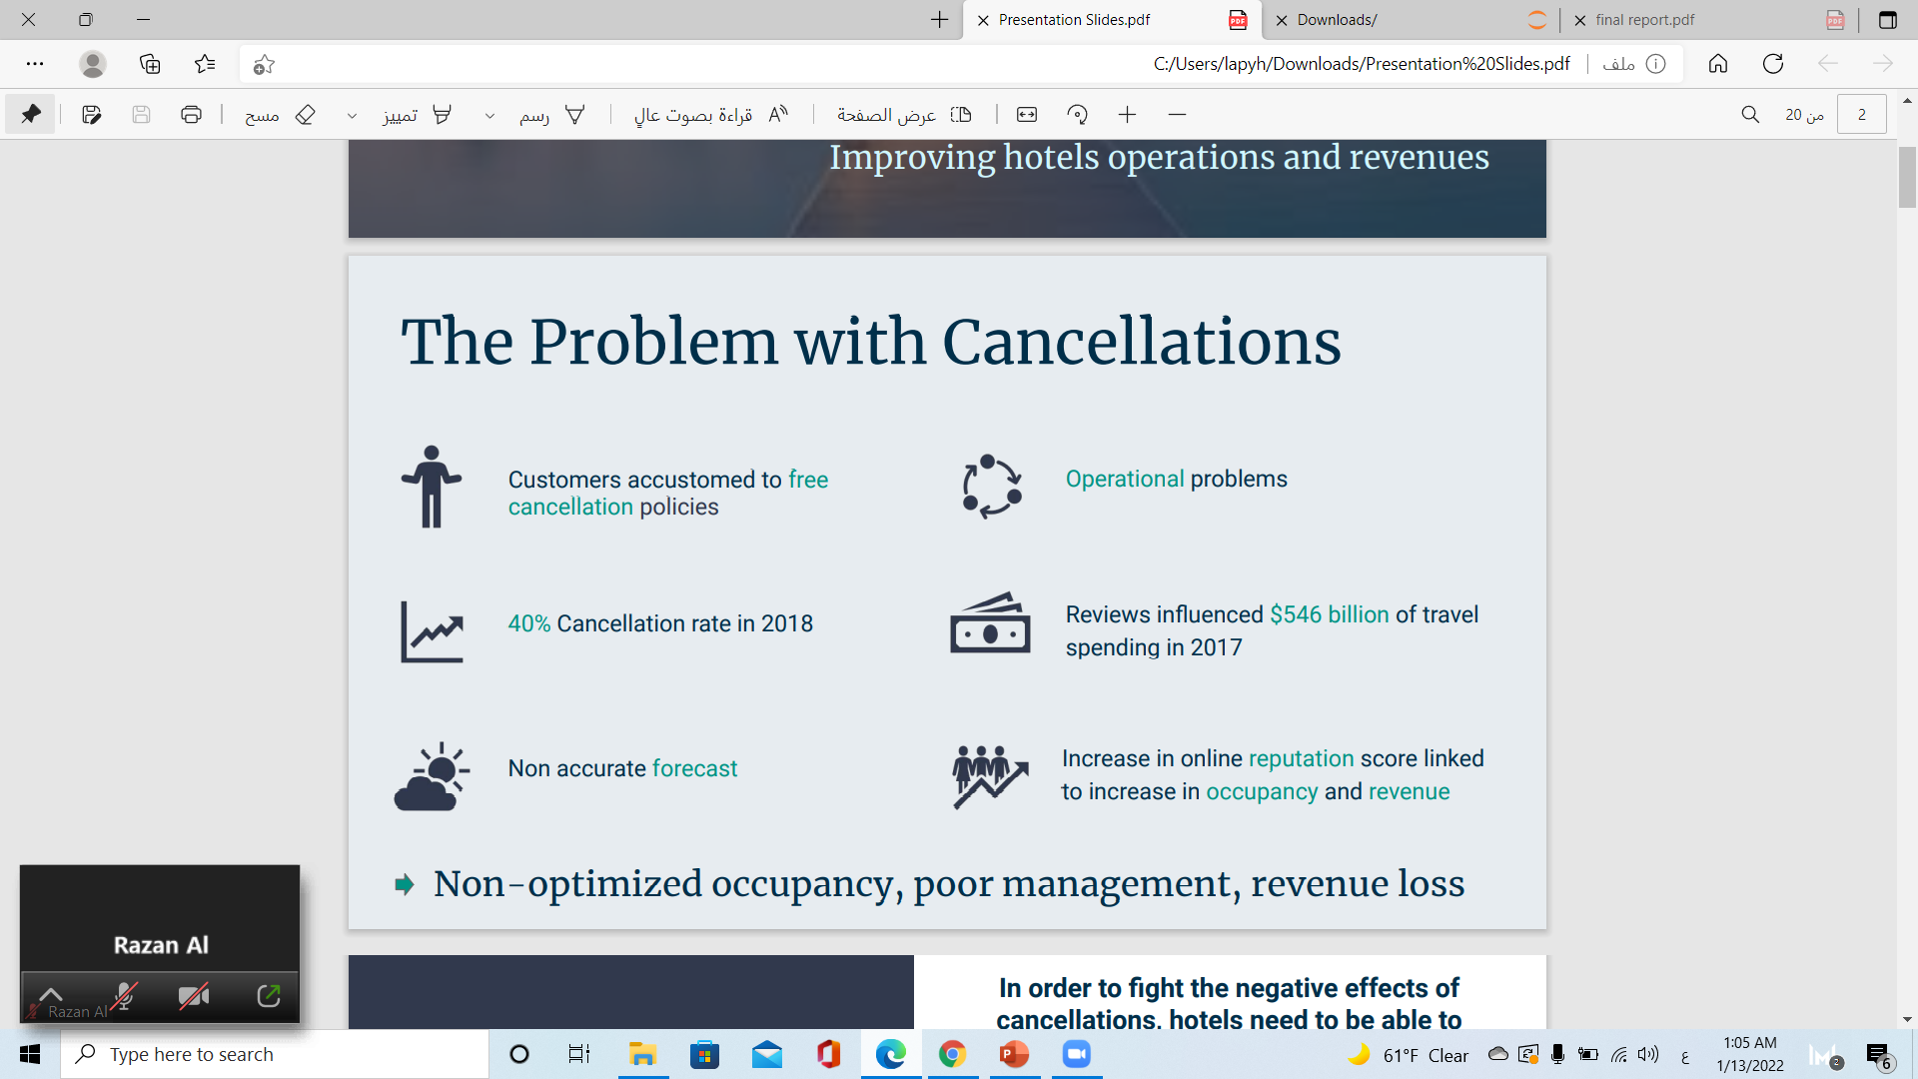
The Problem with Cancellations

Slide 3
The Answer
In order to fight the negative effects of cancellations, hotels need to be able to identify which bookings are likely to be canceled.
We will use a real life hotel booking dataset to create a customer segmentation analysis in order to gain insights about the customers (and hopefully reasons why they cancel their reservation).
We will then build a classification model to predict whether or not a booking will be canceled with the highest accuracy possible. This model will allow hotels to predict if a new booking will be canceled or not, manage their business accordingly, and increase their revenue

Slide 4
The Data Real data from real hotels
We use data from website Kaggle
(Data contains "bookings due to arrive between the 1st of July of 2015 to the 31st of August 2017".
data set contains a single file that compares various booking information between two hotels
(City Hotel, Resort Hotel).
Contains 32 feature & 119364 rows

Slide 5
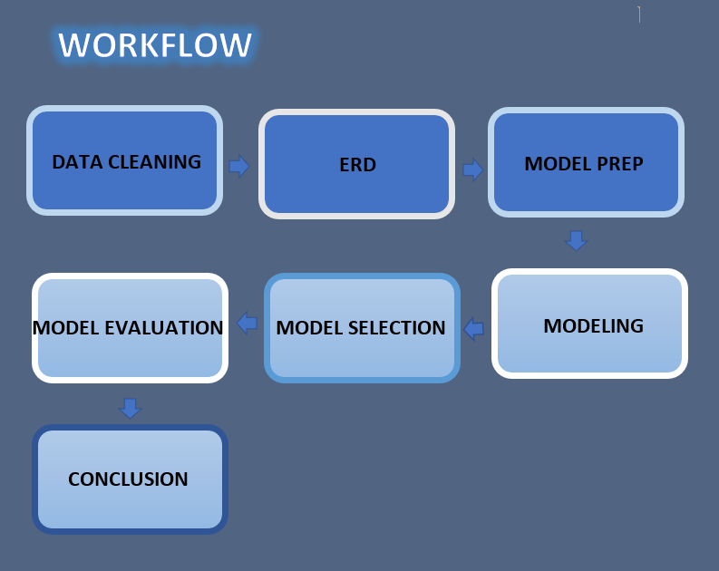

Slide 6
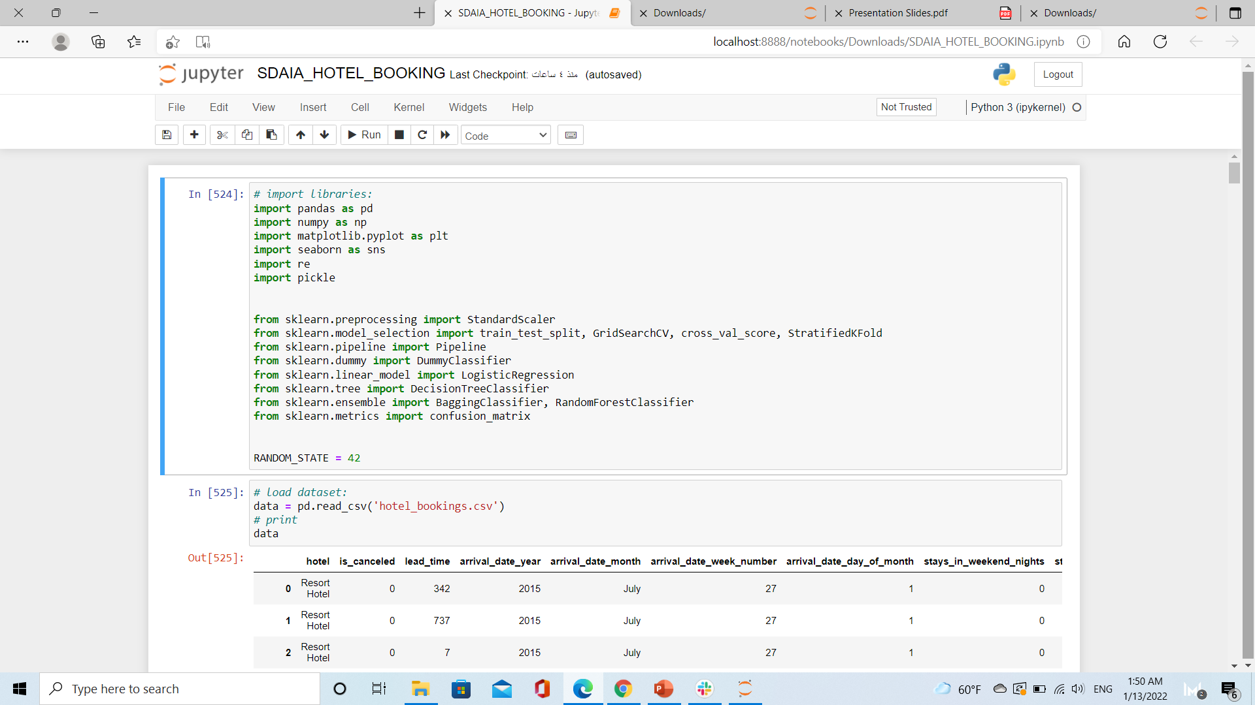
Imort libraries & read Data

Slide 7
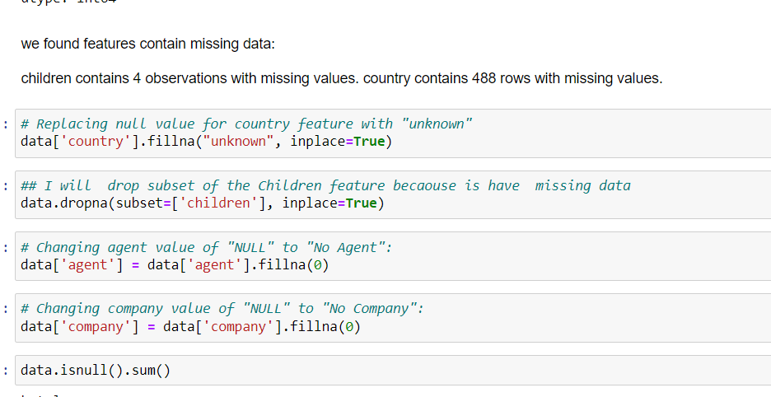
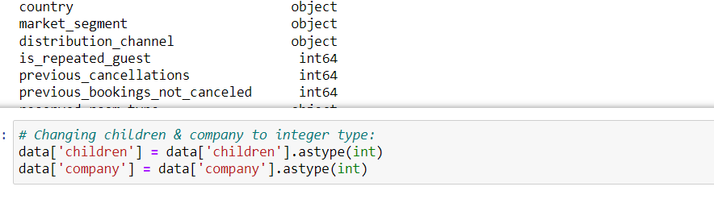
Cleaning Data
Handle with missing values
Change the data type to the appropriate

Slide 8
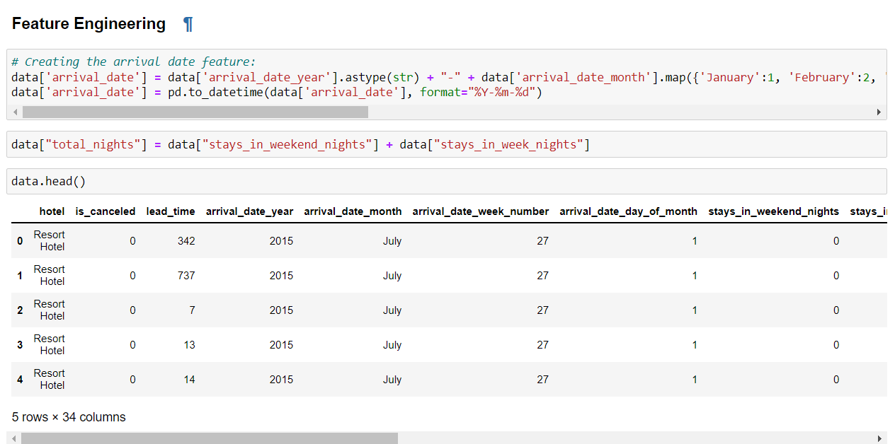
Creating New Feature (Feature Engineering)

Slide 9
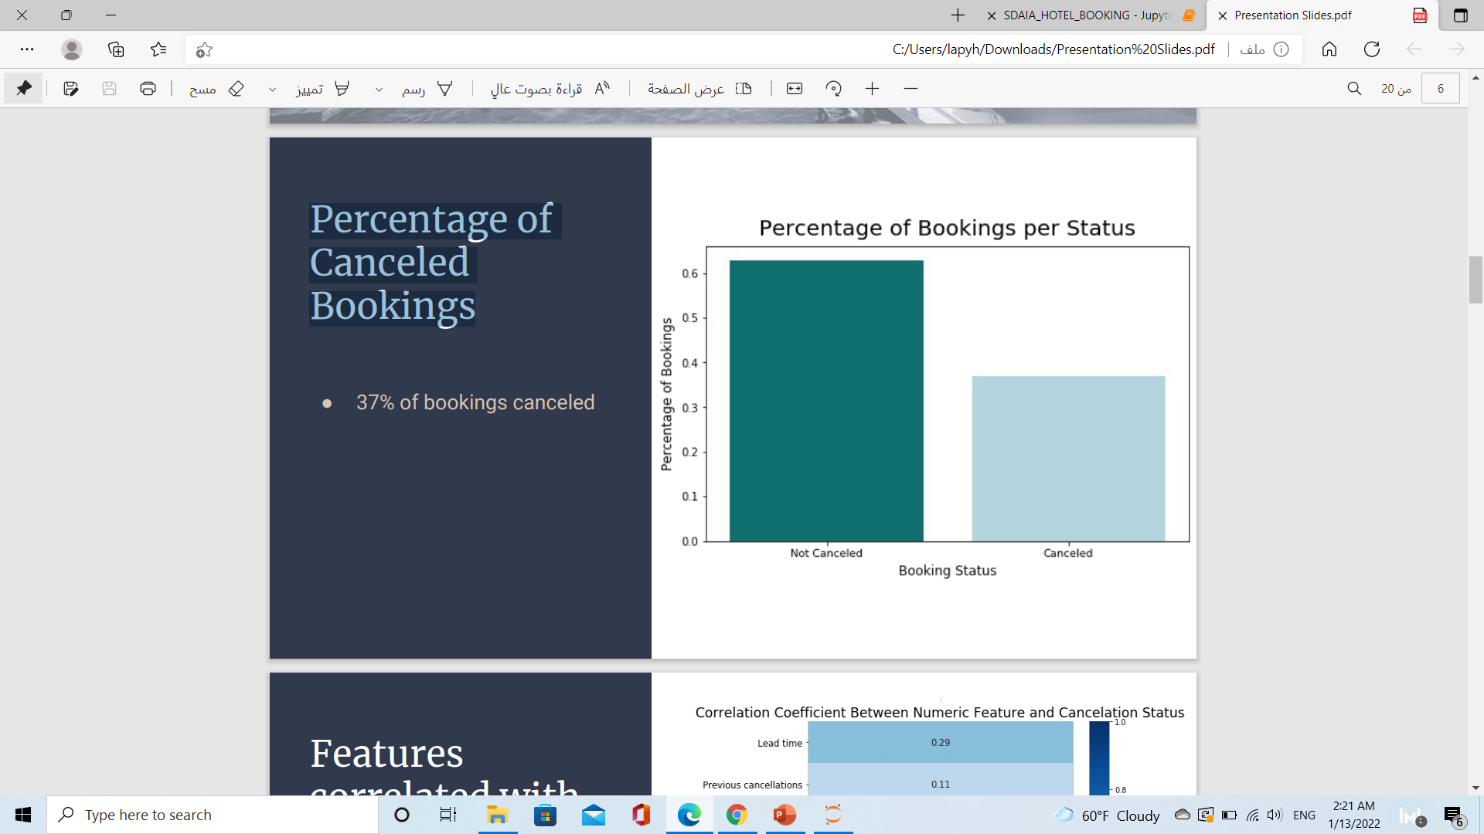
E D A
Percentage of Canceled Bookings
● 37% of bookings canceled

Slide 10
EXPLORATORY DATA ANALYSIS
Which months guests are high?
The above plot shows that August was the busiest month and January was the least (Probably because of the Holiday season in Summer in August and Heavy Winter in January) The high footfall in Jan is followed by July and May
what is the highest month have cancellation ?
The highest cancellation rate was in June then April
what is the percentage of bookings canceled prior to arrival ?
A vast majority of bookings (97%) are canceled prior to arrival.
Were most guests come from ?
Most of the guest are from Portugal then the second is Great Britain,
then Next is France, Spain, Germany, and Ireland

Slide 11
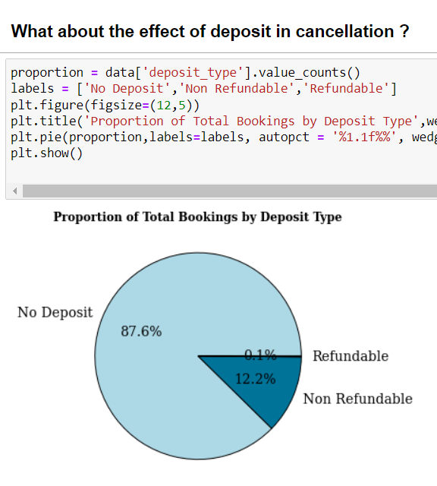
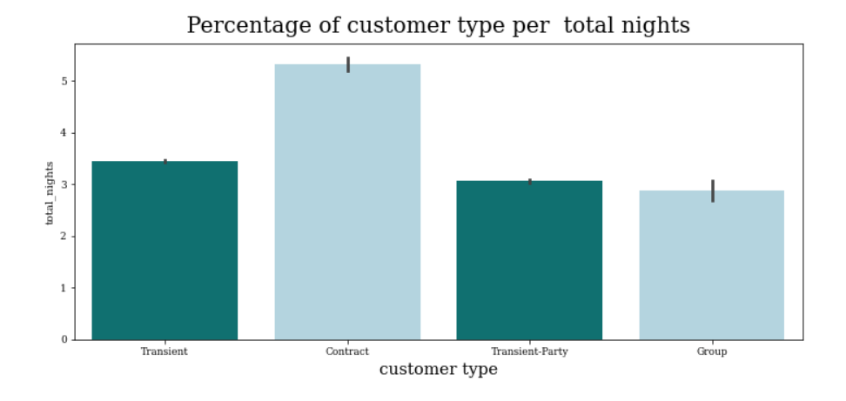
EXPLORATORY DATA ANALYSIS

Slide 12
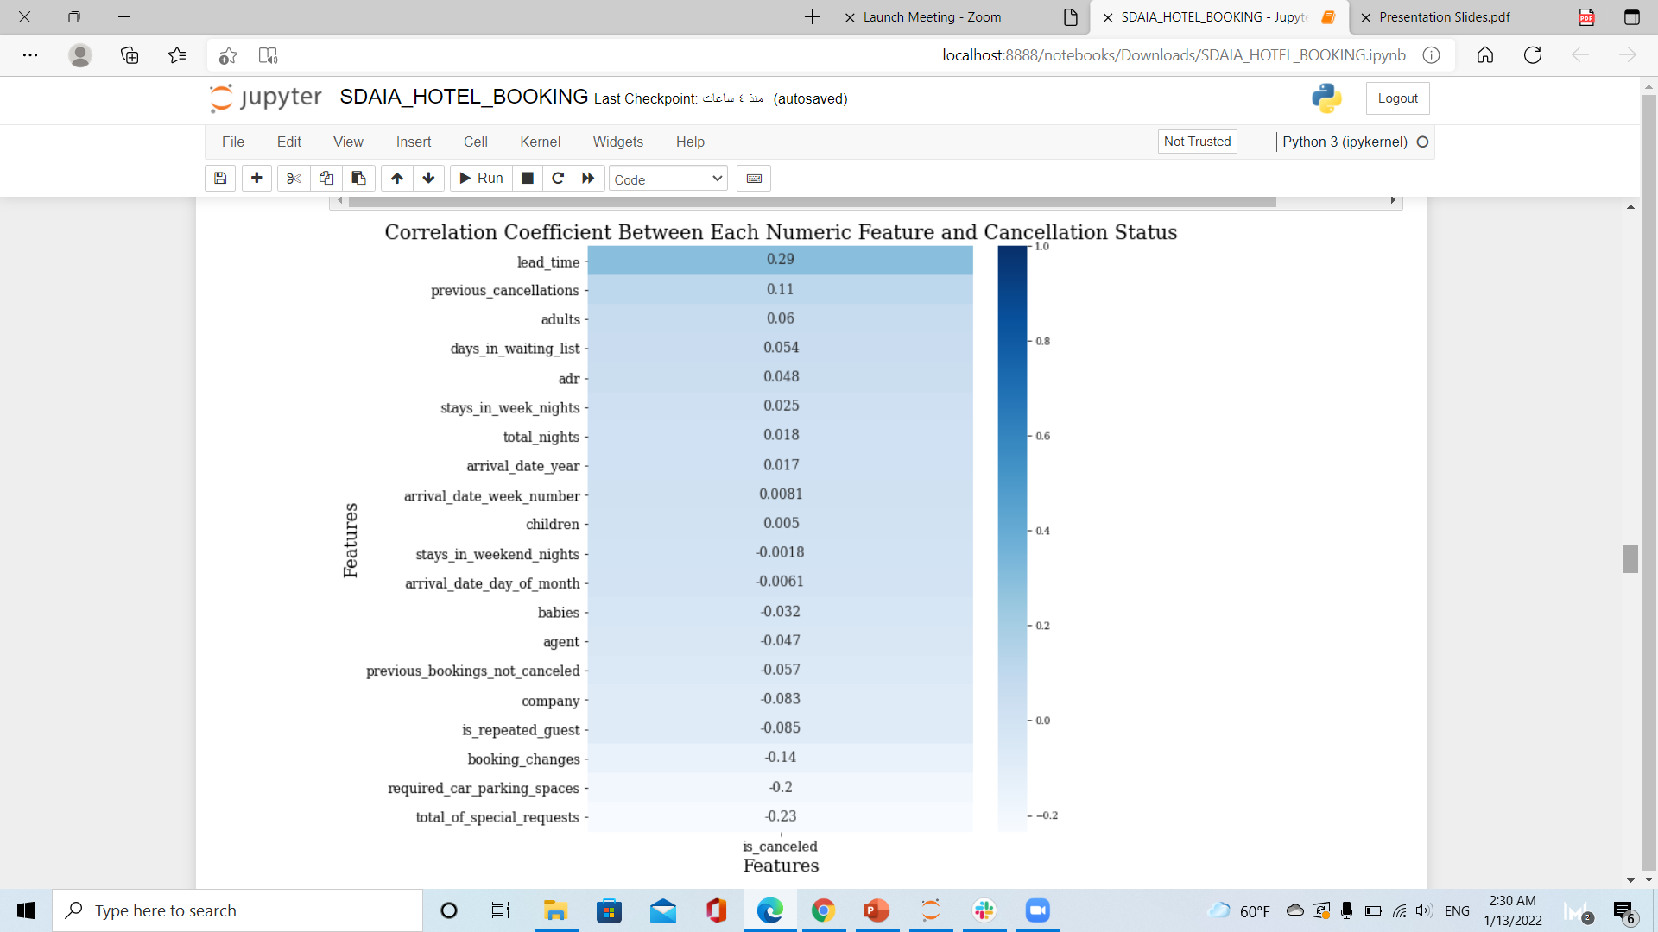
Features
correlated
With
cancellation
● Lead Time
Lead time is the most highly correlated feature with whether or not a booking is canceled

Slide 13
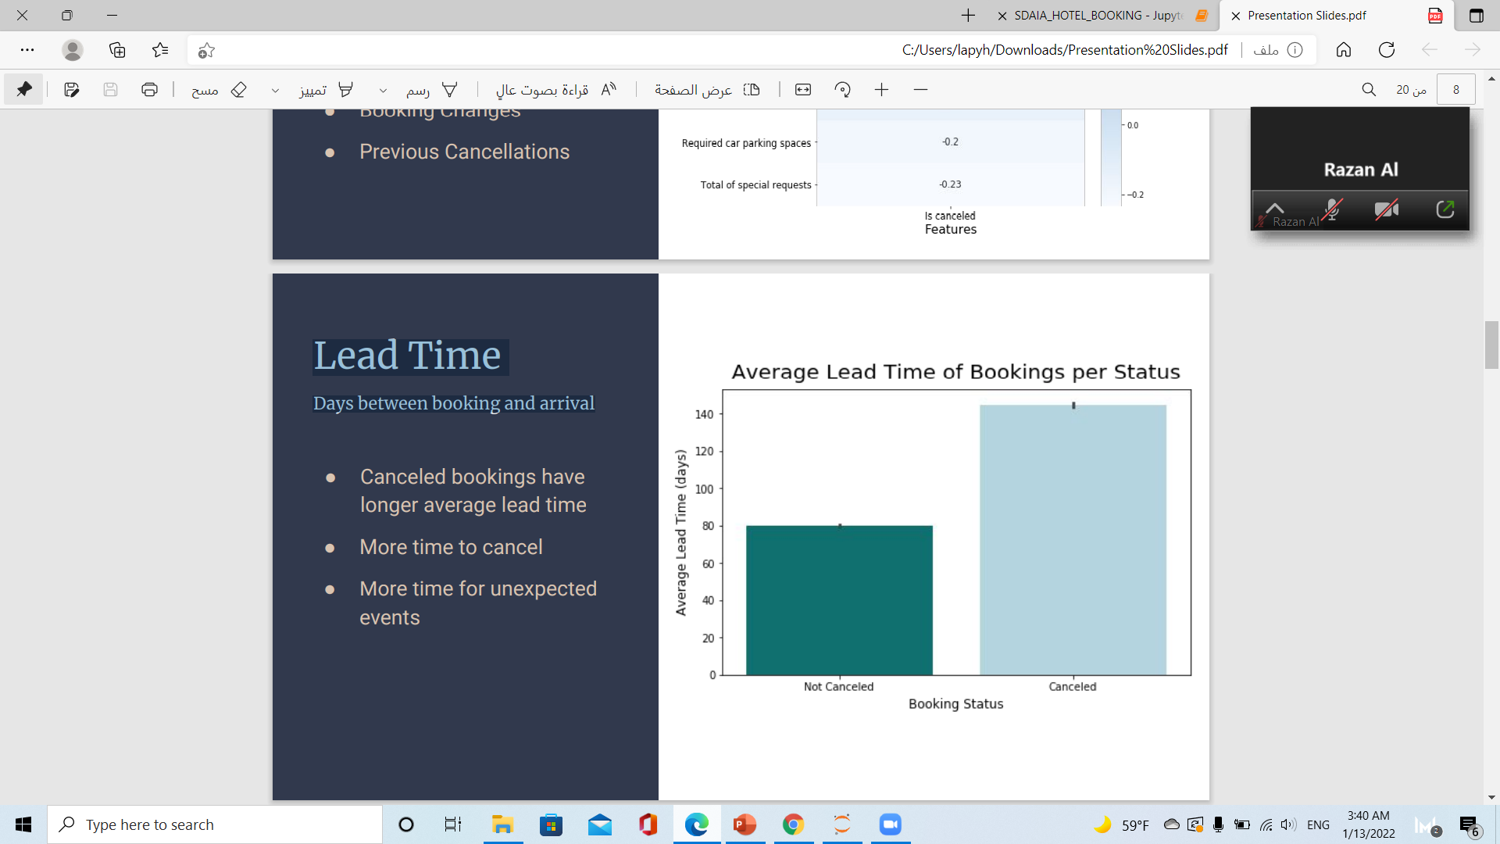
Lead Time Days between booking and arrival
Days between booking & arrival
● Canceled bookings have longer average lead time
● More time to cancel
● More time for unexpected events

Slide 14
Modeling
4
2
1
3
Random Forest
Decision Tree
k-nearest neighbors (KNN)
Logistic Regression

Slide 15
Result
model | accuracy
0 | Decision Tree | 0.83
1 | Random Forest | 0.87
2 | KNN | 0.82
3 | Logistic Regression | 0.78

Slide 16
Conclusion
We identified a Random Forest as the model giving us the highest predictive power.
This model classifies whether or not a booking will be canceled with 87% accuracy.
As a result, this model would allow hotels to more accurately forecast their occupancy, manage their business accordingly, and increase their revenue

